Slide 1

"ATM Innovations: Revolutionizing the Banking Experience"
11

Slide 2
INTRODUCTION
An Automated Teller Machine (ATM) is a self-service machine that allows bank
customers to carry out a variety of financial transactions without the need for
human assistance. These machines are typically located in convenient public
places like shopping malls, airports, train stations, and bank branches.
The first ATM was introduced in the late 1960s and since then, they have
become an essential part of the modern banking system. With an ATM,
customers can withdraw cash, check account balances, transfer funds
between accounts, and perform other basic banking functions.
ATMs are typically accessed using a plastic card that contains a magnetic stripe
or a microchip. Customers insert their card into the ATM and enter a personal
identification number (PIN) to authenticate their identity. Once authenticated,
they can select the desired transaction from a menu on the screen and follow
the on-screen prompts to complete the transaction.

Slide 3
ABSTRACTS
An Automated Teller Machine (ATM) is an electronic device that allows customers of financial institutions to perform various banking transactions, such as withdrawing cash, checking account balances, transferring funds, and paying bills, without the need for a human teller. ATMs have become ubiquitous and convenient for customers, as they are available 24/7 and can be found in a variety of locations, including banks, convenience stores, and malls. The use of ATMs has greatly reduced the need for customers to visit a physical bank branch, saving time and increasing efficiency in banking transactions.

Slide 4
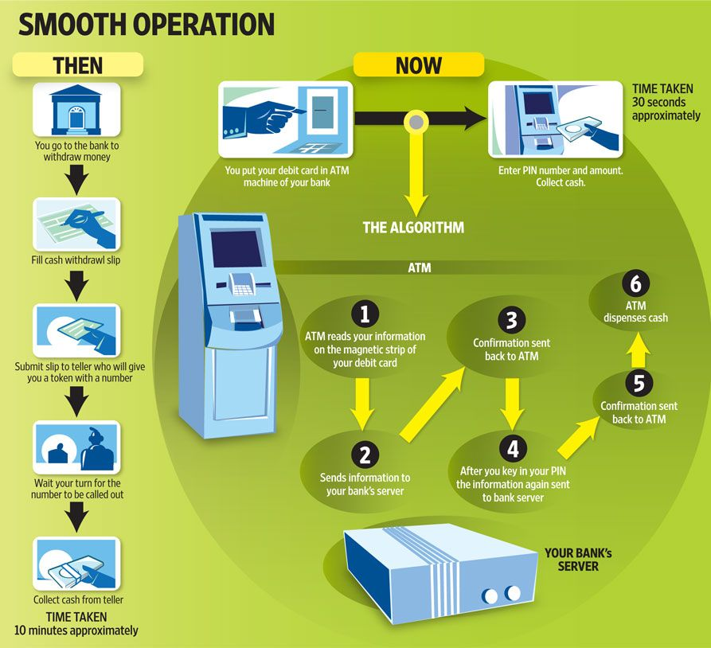

Slide 5
System Requirement
Hardware requirements
Central processing unit (CPU): A high-performance CPU is required to run the operating system and handle the processing of ATM transactions.
Memory: Sufficient memory is necessary to ensure that the system can handle multiple transactions simultaneously and maintain the required speed and performance.
Storage: Adequate storage is needed to store the ATM software, transaction logs, and other data that the system needs to operate.
Input/output devices: An ATM requires various input/output devices, such as a touch screen display, keypad, card reader, receipt printer, cash dispenser, and deposit module.
Network connectivity: The ATM must have a reliable and secure network connection to the financial institution's servers and other systems.
Security features: The ATM must include advanced security features to protect customer information and prevent fraud, such as encryption, anti-skimming technology, and physical security measures like locks and alarms.
1.

Slide 6
2. Software requirements
Operating System: An operating system like Windows or Linux is required to run the ATM software and manage the system resources.
ATM Software: The ATM software is responsible for managing user interactions, processing transactions, and communicating with the financial institution's servers and other systems.
Security Software: Advanced security software is necessary to protect customer information and prevent fraud, including encryption, anti-skimming technology, and real-time monitoring.
Network Software: Network software is needed to manage the network connection and facilitate communication between the ATM and the financial institution's servers and other systems.
Database Software: Database software is required to store and manage transaction data, user profiles, and other critical information.
Application Programming Interfaces (APIs): APIs are needed to integrate with other banking systems and services, including mobile banking apps and third-party payment processors.

Slide 7
Advantages of ATM
Convenience: ATMs are available 24/7, making it easy for customers to perform transactions whenever they need to, without needing to visit a physical bank branch.
Accessibility: ATMs are located in various locations, including banks, shopping centers, and convenience stores, making them easily accessible to customers.
Time-Saving: ATMs allow customers to perform transactions quickly, without the need to wait in long lines at the bank.
Security: ATMs are designed with advanced security features such as PINs, encryption, and anti-skimming technology to protect customer information and prevent fraud.
Increased Efficiency: ATMs increase the efficiency of banking transactions by reducing the need for bank tellers to perform routine tasks, allowing them to focus on more complex tasks that require personal attention.
Cash Availability: ATMs provide customers with quick access to cash, eliminating the need to visit a bank branch during business hours to withdraw money.

Slide 8
What is an ATM Card?
ATM cards are payment cards issued by banks. They are linked to your bank account, and you can use them for withdrawing money from ATMs. Most of the ATM cards can now be used for online and offline transactions.
Debit Cards were then introduced to eliminate this limitation. You can now use debit cards for withdrawing money as well as for online and offline transactions. You can get one by opening a Savings Account at a bank.
Most of the banks now offer custom cards with the name of the account holder mentioned on the card. Apart from your name, the validity of the card, 16-digit card number, logo of card network, and Card Verification Value (CVV) is mentioned on the card. The latest ATM cards also feature a Europay Mastercard and Visa (EVM) chip.

Slide 9
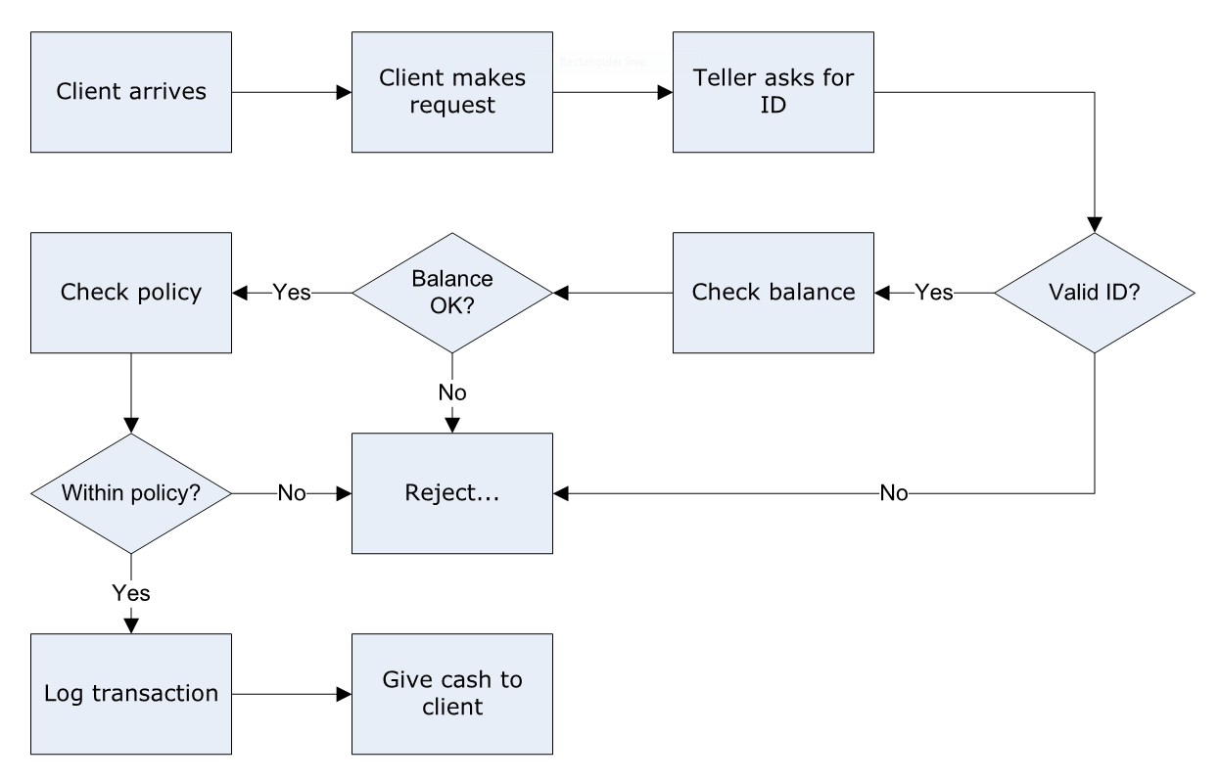
FLOWCHART

Slide 10
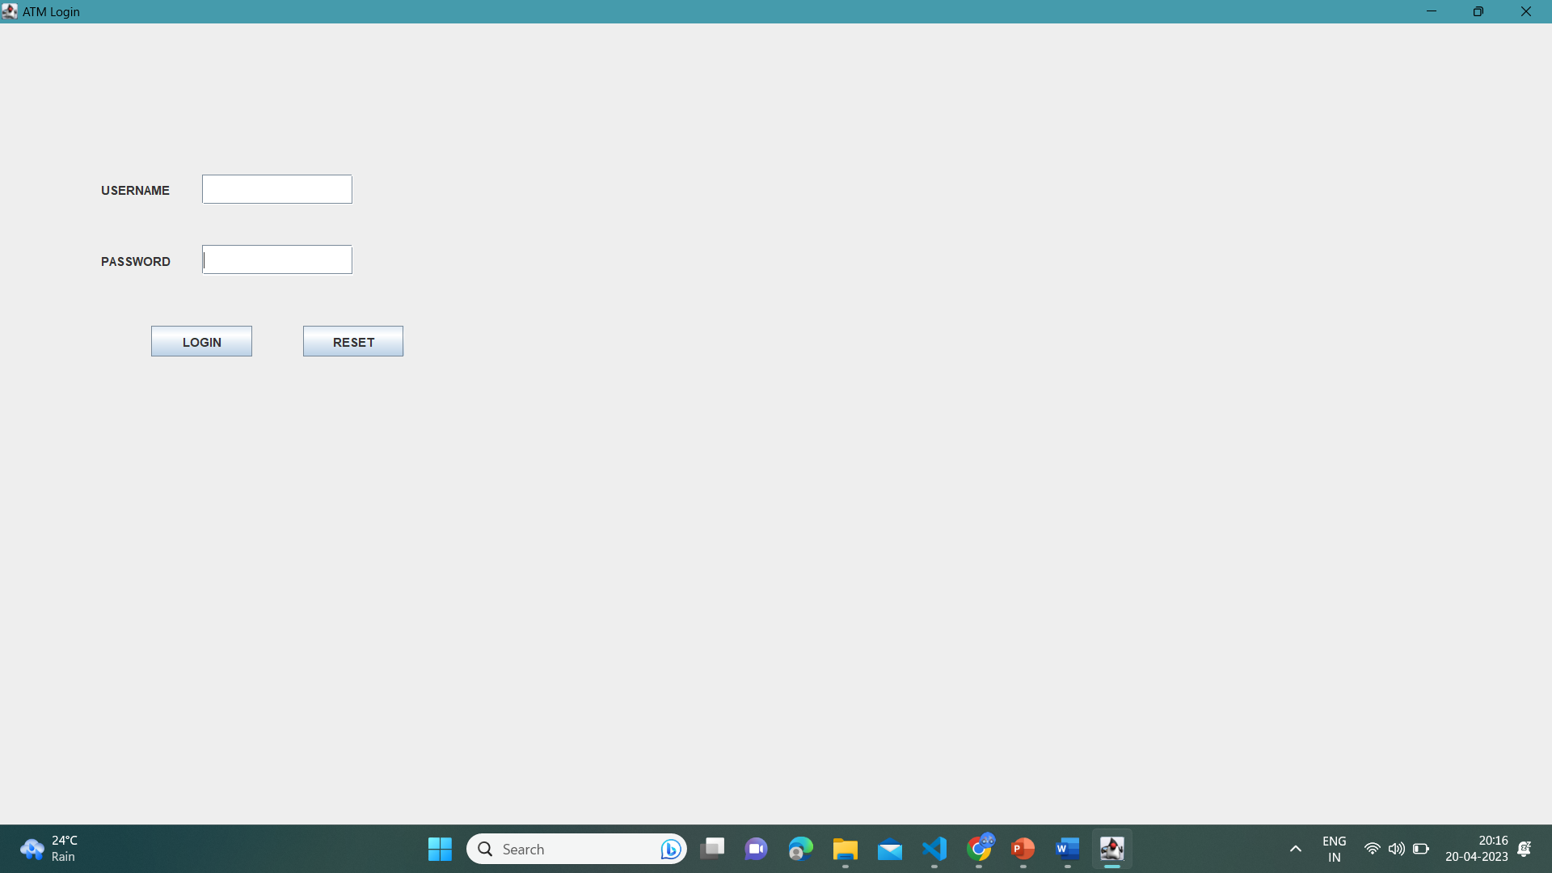
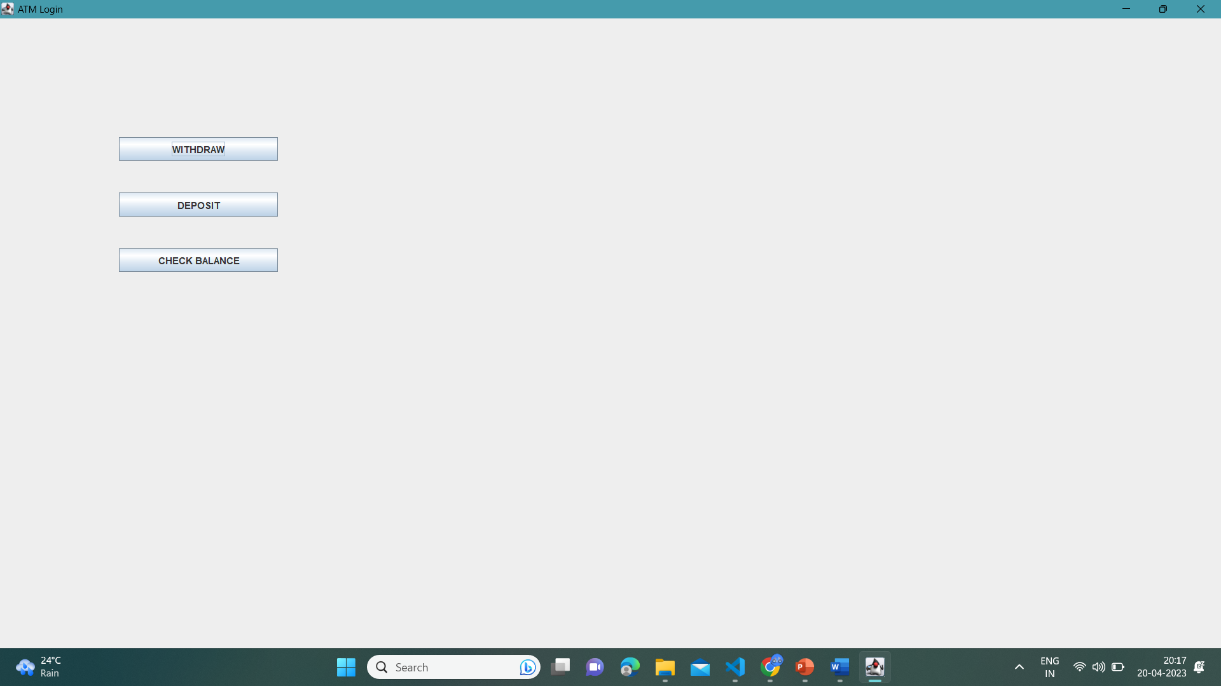
output

Slide 11
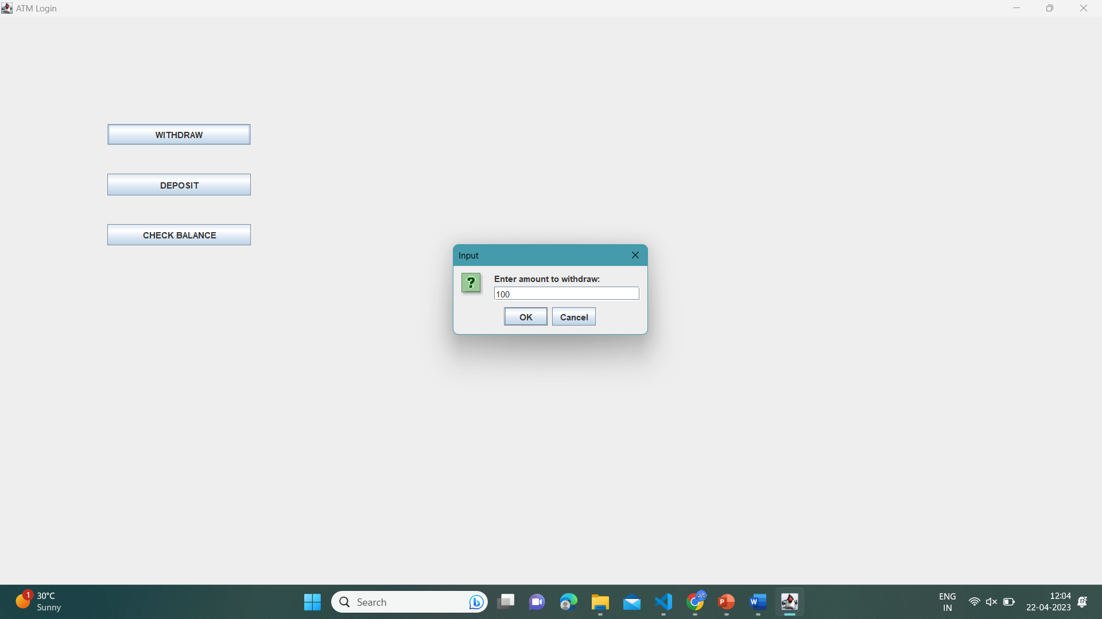
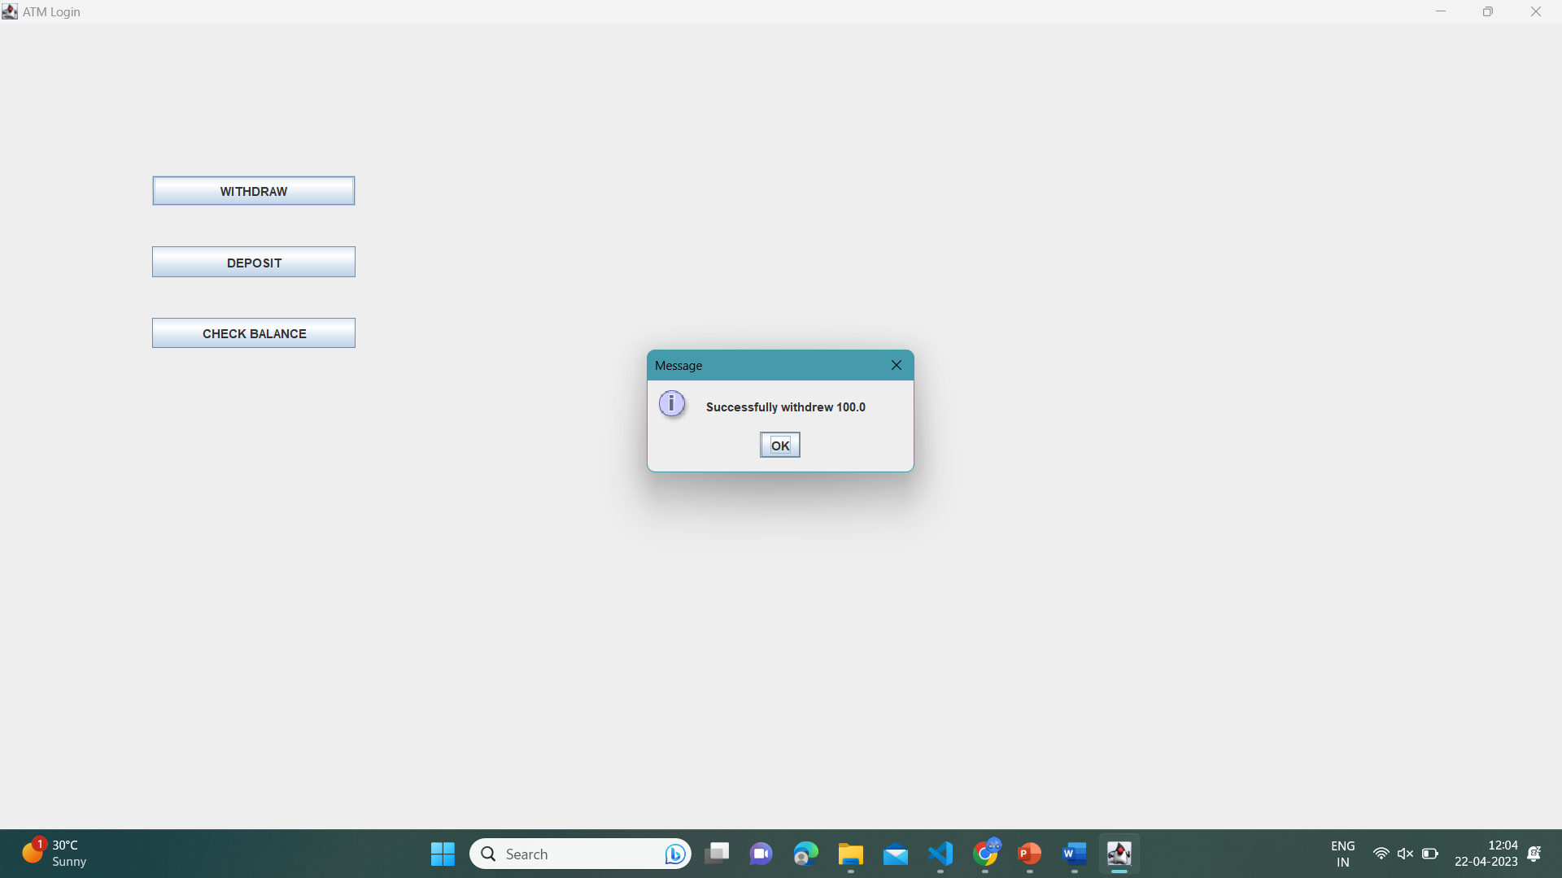
1

Slide 12

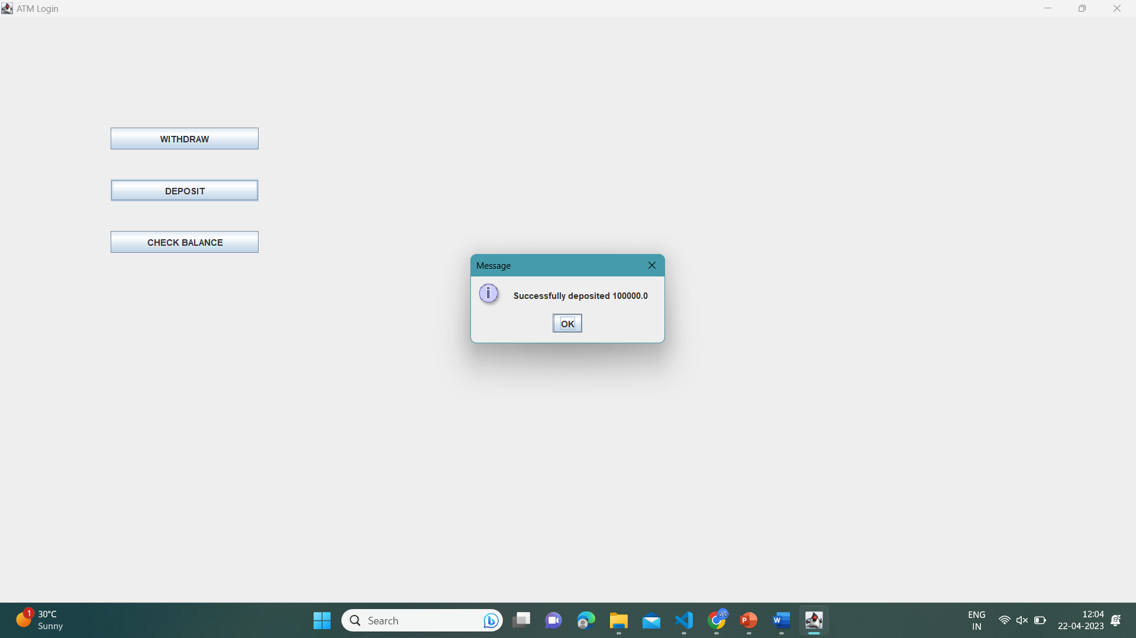
2

Slide 13
Conclusion
ATMs are an important part of the modern banking system, providing customers with easy and convenient access to financial services. The benefits of ATMs include their availability 24/7, accessibility in various locations, time-saving, increased efficiency, security, and quick access to cash.
The success of ATM systems relies on the integration of advanced hardware and software components, including high-performance CPUs, adequate memory and storage, input/output devices, network connectivity, and security features like encryption and anti-skimming technology. The software requirements for an ATM system include the operating system, ATM software, security software, network software, database software, and APIs.
Overall, ATMs have revolutionized the banking industry, making it easier and more convenient for customers to perform transactions, access their accounts, and manage their finances. As technology continues to advance, we can expect to see further innovations in the ATM industry, providing even more benefits to customers and financial institutions alike.

Slide 14
Future Enhancements
Biometric Authentication: The addition of biometric authentication technology, such as fingerprint or facial recognition, could help to further increase the security of ATM transactions.
Contactless Transactions: The implementation of contactless payment methods, such as NFC or QR codes, would allow customers to make transactions without physically touching the ATM, providing a more hygienic and convenient experience.
Integration with Mobile Devices: Integrating ATMs with mobile devices could enable customers to perform transactions directly from their smartphones or tablets, eliminating the need to physically visit an ATM.
Personalization: ATMs could be enhanced to provide a more personalized experience for customers, such as displaying account balances, offering customized transaction options, and providing tailored promotions.
Voice Recognition: The integration of voice recognition technology could enable customers to perform transactions by speaking to the ATM, providing a more accessible and user-friendly experience for those with disabilities or language barriers.
Artificial Intelligence: The use of artificial intelligence (AI) could enable ATMs to provide personalized recommendations and predictive insights based on a customer's transaction history and behavior.

Slide 15
SCOPE
The scope of an ATM (Automated Teller Machine) machine is primarily to provide basic financial services such as cash withdrawals, balance inquiries, and deposits. However, depending on the type and functionality of the ATM, it may also offer additional services such as:
Bill payments: Some ATMs allow customers to pay bills for utilities, phone, or credit card bills.
Fund transfers: Certain ATMs provide the facility to transfer funds between accounts or to other banks.
Mobile top-ups: Some ATMs allow customers to top up their mobile phones.
Account statements: Customers can request their account statements at certain ATMs.
Cash or check deposits: Some ATMs allow customers to deposit cash or checks into their accounts.
Foreign currency exchange: Certain ATMs located at airports or tourist locations provide foreign currency exchange services.

Slide 16
THANK YOU !

